Slide 1
IPv6 and IPsec
IP Service | IPv4 Solution | IPv6 Solution
Addressing Range | 32bit,Network Address Translation (NAT). Approximately over 4 billion addresses,2^{32.} | 128, Multiple Scope. 340 undecillion addresses, 34^{28.}
Autoconfiguration | DHCP | Stateless, Stateful(DHCPv6)
Security | IPSec | Heterogenous-IPsec, end-to-end encryption.
Mobility | Mobile IP | Mobile IP with optimised routing.
Quality of Service | Differentiated service, integrated service. | Differentiated service, integrated service.
IP Multicast | IGMP/Multicast BGP | MLD/Multicast BGP

Slide 2
DNSSec

Slide 3
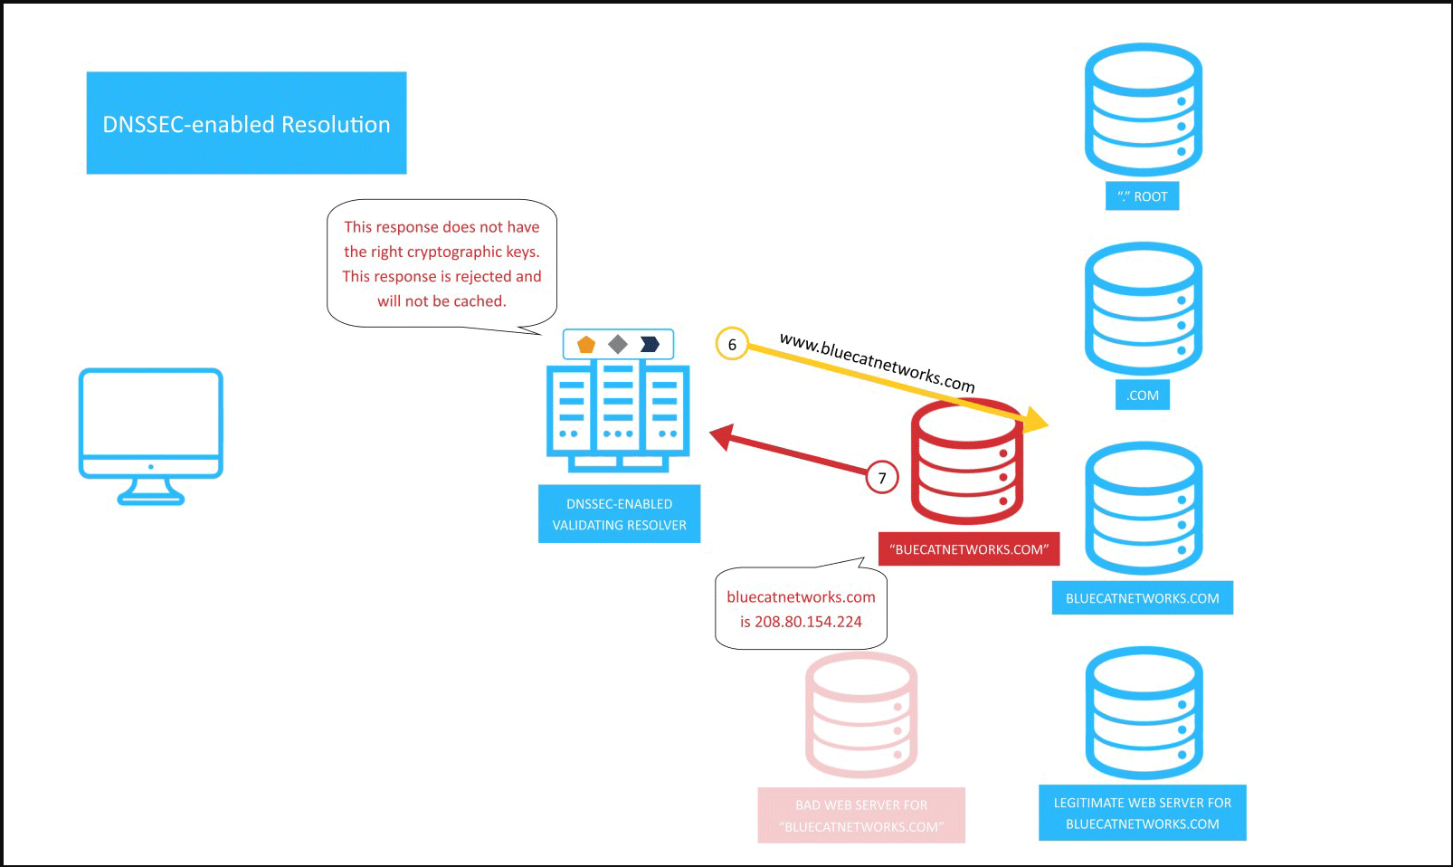
DNSSec

Slide 4
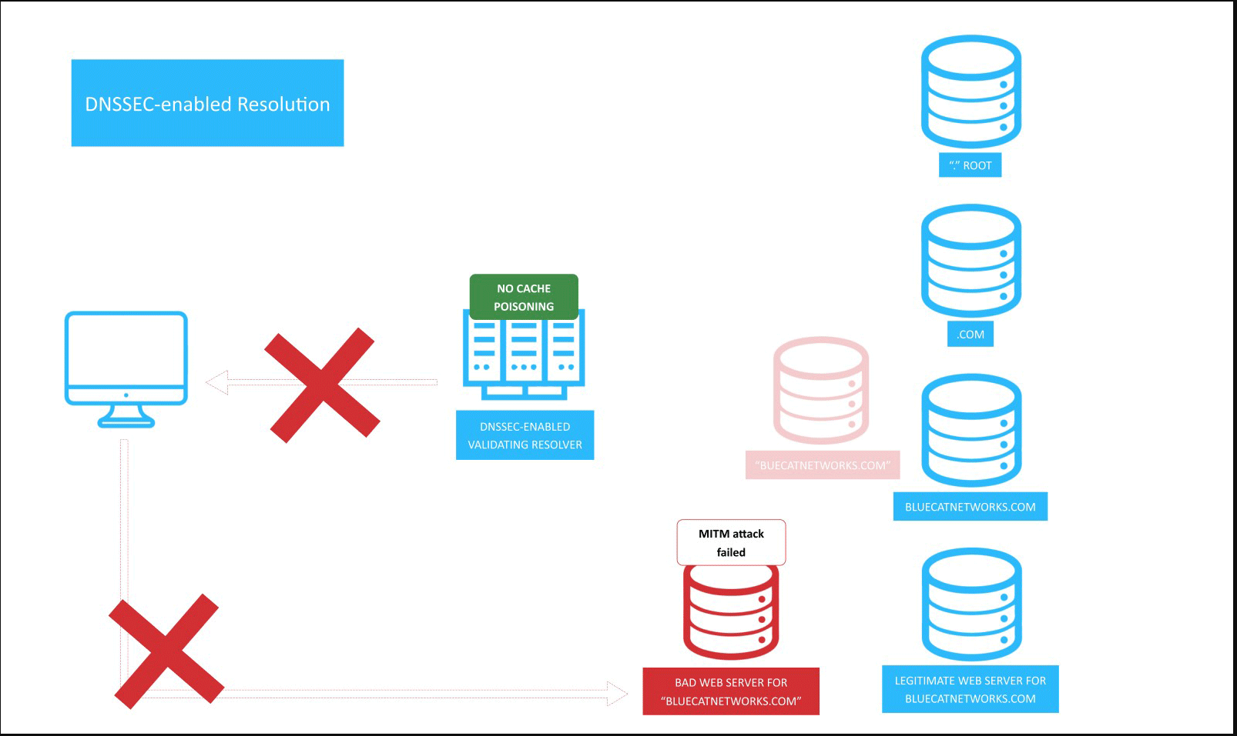
DNSSec

